Slide 1
In and For Community: Helpful Models in Churches Dr. Amy L. Sherman

Slide 2
BEFORE AFTER

Slide 3
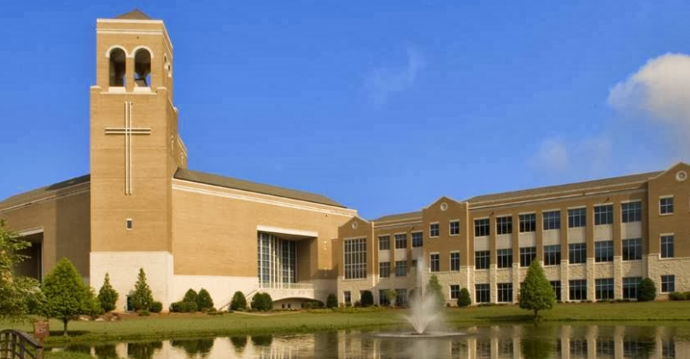
Perimeter Church, Atlanta

Slide 4
Perimeter Church: “Before”

Slide 5
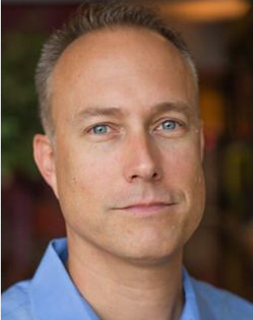
Perimeter Church: “After”
Travis Vaughn

Slide 6
Perimeter Church: “After”
Revised Church Officer Training
Special Event with Mike Goheen
5-week sermon series

Slide 7
Perimeter Church: “After”
Revised Church Officer Training
Special Event with Mike Goheen
5-week sermon series

Slide 8
Perimeter Church: “After”

Slide 9
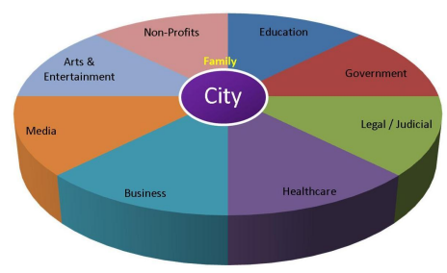
Perimeter Church: “After”

Slide 10
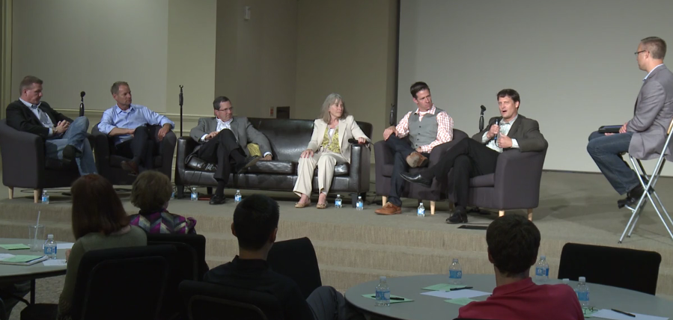
Perimeter Church, Atlanta

Slide 11
Perimeter Church: “After”

Slide 12
The National VILC Initiative
➢ Launched 2012-1013
➢ 42 Congregations in total
➢ Church teams = 1 to 2 pastors plus a marketplace layperson(s)
➢ Gather 4 times face-to-face (including the field experience at Acton U)

Slide 13
VILC: Primary Objectives
➢Participating pastors implementing more and better preaching and teaching on faith, work, vocation, and economics;
➢ Participating members forging new friendships leading to more sustained infusion activities, as well as new partnerships for effective whole-life discipleship and city flourishing;

Slide 14
VILC: Primary Objectives
➢Participating marketplace lay leaders engaging in new or deepened practices of faith-work integration at their jobs and communicating excitement about this to their friends at work and church;
➢Participating churches implementing actions that increase emphasis on vocational stewardship throughout all their congregational ministries (e.g., liturgies, adult education programs, small groups, youth and children’s ministries, local and foreign missions), such that this commitment becomes a permanent
part of the churches’ DNA;

Slide 15
VILC: Primary Objectives
➢Participating churches engaging in teaching and activities that help congregants to be effectively equipped, encouraged, and deployed to love and serve their neighbors and advance the common good in their communities in and through their daily callings.

Slide 16
5 Lessons Learned
How Could These Lessons Shape Your School’s Approach to Equipping Church Leaders?

Slide 17
1) Leaders need exposure and education via an experiential pedagogy
“The VILC was more than just hearing ideas. It was experiencing them. The venues provided different ways of seeing the teaching actually worked out.”

Slide 18
Leaders need exposure and education via an experiential pedagogy
From Mike Breen, Building a Discipling Culture

Slide 19
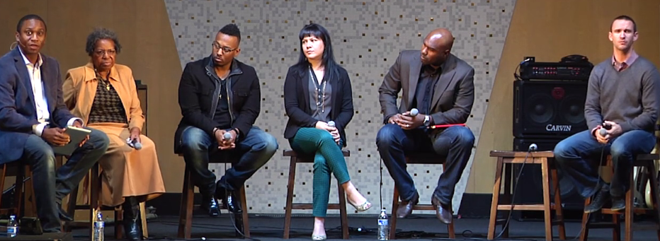
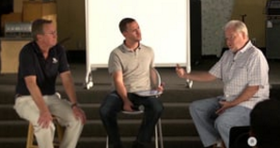
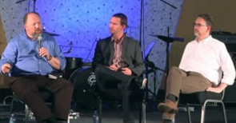
Experiencing Surge School

Slide 20
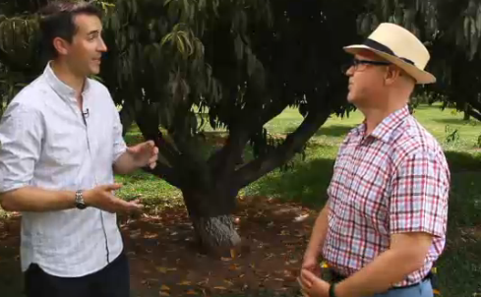
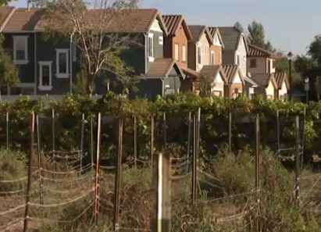
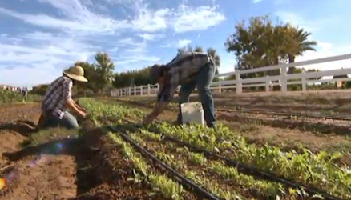
Experiencing Agritopia

Slide 21
What Can Seminaries Do?
➢The Asbury Project
➢IWU’s Business Internship
➢Inviting Marketplace Christian Leaders into the Classroom
➢Taking students on site to businesses operated by Christian leaders with a strong grasp of whole-life discipleship

Slide 22
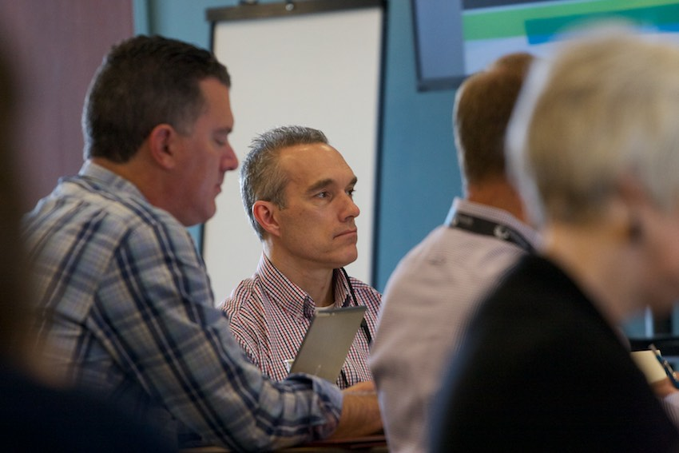
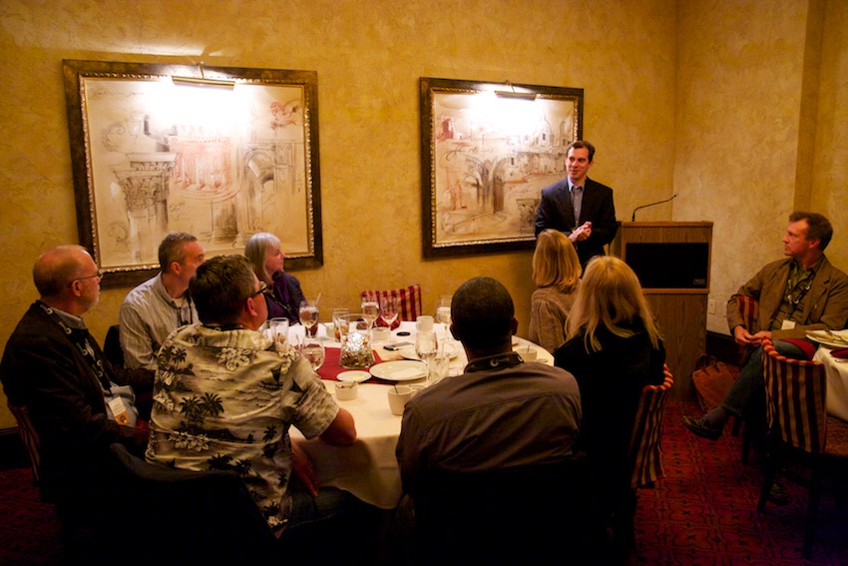
2) It’s important for pastors and congregants to learn TOGETHER

Slide 23
2) It’s important for pastors and congregants to learn TOGETHER
“For Andy and Brian to be part of the VILC is exciting for me because they’ve taken on the task of making all this understandable. .. They’ve experienced it and they can teach it to other folks in ways I can’t possibly do.”
--Pastor Bryan Morgan

Slide 24
What Can Seminaries Do?
➢Gordon-Conwell’s Church-based Entrepreneurship
➢Assign students to work with marketplace leaders in a church to develop a small group curriculum on faith-work integration
➢Support innovative, hands-on D.Min. projects like Kent Duncan’s on “messaging faith and work integration among blue-collar laborers”
➢Encourage students/pastors to invite a couple of marketplace congregants to seminars/events they
are attending to learn about FWE

Slide 25
3) Leaders Must Equip the Scattered Church Theologically
➢About CREATION
➢About GOD’s MISSION in the World
➢About the CHURCH’s MISSION
➢About DISCIPLESHIP

Slide 26
What Can Seminaries Do?
➢Teach it!
➢Grasp Paul Williams’ insights about hermeneutics that “equip ministers for the wider Church and culture”

Slide 27
4) Preaching isn’t Enough. Celebration is Needed!

Slide 28
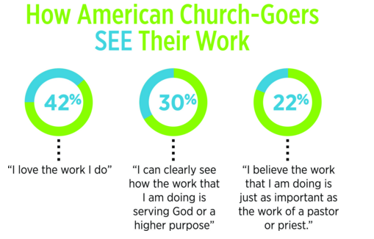

Slide 29
Preaching Isn’t Enough. Celebration is Needed!
“I realized that the issue was not with what our people heard, but with what they saw. Our congregants frequently heard teaching about the importance of vocation and all-of-life-discipleship, but they weren’t seeing anyone’s work—apart from pastoral, missionary, and nonprofit work—publicly
celebrated.”
--Pastor Jim Mullins

Slide 30
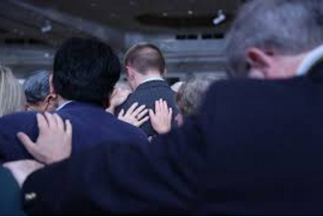
Celebrate: Commissioning
➢COMMISSIONING

Slide 31
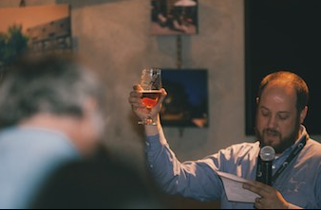
Celebrate: Blessing a Business

Slide 32
Celebrate: Visuals at Christ Community Church
OUGHT IS CAN WILL

Slide 33
What Can Seminaries Do?
➢Provide resources (prayers, liturgies, songs)
➢Bring in pastors like Tom Nelson and others who teach well on the hard work of shaping church culture
➢Assign students to write their own prayers, liturgies
➢Give assignments like “interview 5 congregants about how their faith shapes their work”

Slide 34
5) Churches Infusing FWE Effectively are DOING!!!
➢Practical help for the un- and underemployed; for those in vocational discernment phase

Slide 35
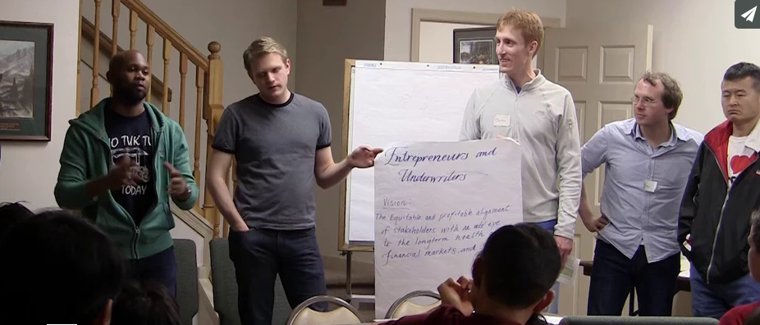
➢Vocational affiliation groups (e.g., medicine, law)

Slide 36
➢Missions Conference That Highlight the Great Commission 2.0
Go into all the world; that is, all the social sectors—law, finance, business, healthcare, government, media, education, arts—and work there for shalom.

Slide 37
What Can Seminaries Do?
➢Assign students to research models and write short case studies
➢Create independent study courses in which students write a blueprint for a new FWE ministry
➢Help students see how to infuse into existing ministries new emphases on vocation

