Slide 1
In and For Community: Helpful Models in Theological Schools Dr. Amy L. Sherman

Slide 2
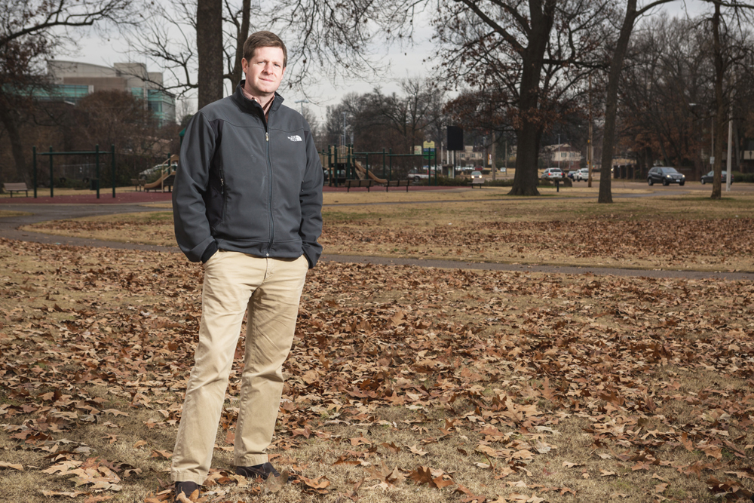
Greg Spillyards

Slide 3
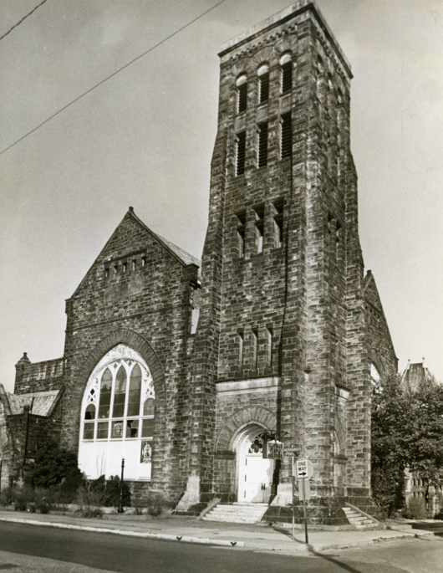
Clayborn Temple,
Memphis, TN

Slide 4
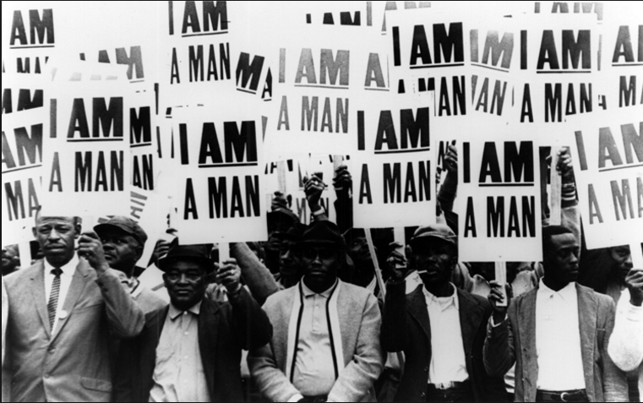
1968 Memphis Sanitation Workers’ Strike

Slide 5
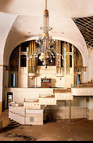
Clayborn Temple Restoration

Slide 6
Asbury Theological Seminary

Slide 7
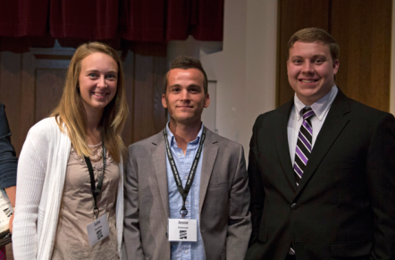
Asbury Theological Seminary

Slide 8
Asbury Theological Seminary
“Bringing revival and transformation to our community through the grace and love of Jesus Christ”

Slide 9
The National Fellows Initiative
Launched 1995
➢ 21 Sites at Local Churches nationally

Slide 10
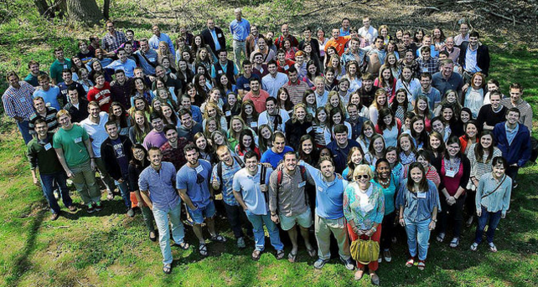
The National Fellows Initiative

Slide 11
The National Fellows Initiative
Southeastern Baptist Theological Seminary
Reformed Theological Seminary
Trinity Evangelical Divinity School
Birmingham Theological Seminary
Gordon-Conwell Seminary*
Covenant Seminary

Slide 12
The National Fellows Initiative
A Win-Win Relationship

Slide 13
Partnering with Nonprofits: CCDA

Slide 14
CCDA Partnership
Denver Seminary
Sioux Falls Seminary
Drew University Divinity School
North Park Seminary
Wesley Seminary (IWU)
Calvin Seminary
Martin University
Bakke Graduate School

Slide 15
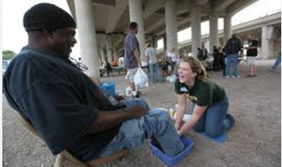
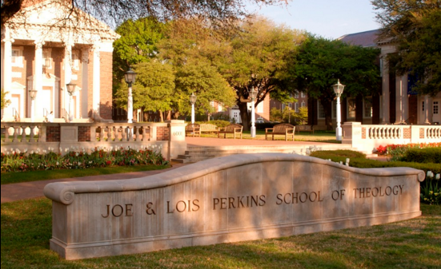
Perkins Seminary & Mission Waco

Slide 16
Partnering with Businesses: IWU

Slide 17
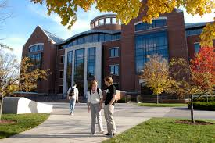
IWU School of Theology & Ministry

Slide 18
IWU’s Business Internship
Launched in 2012
126 Hour Experience
60 Students Involved To Date

Slide 19
IWU’s Business Internship
Do you anticipate being a different kind of pastor than you might have been if you’d not had this experience?

Slide 20
IWU School of Theology & Ministry
“Everything I’d say in a sermon, I realized, was built for educated people, middle class and higher. Now I’ll preach to the working classes better.”
-- Ethan

Slide 21
The Fruit of Partnerships
The practical training and expanded vision that these future pastors are receiving is equipping them to lead churches that will place a high value on serving their community.

